Slide 1

QMET 510 – Data Analysis Project
Kickstarter - Ankur Kumar

Slide 2


Dataset
“Kickstarter is a funding platform for creative projects. Everything from films, games, and music to art, design, and technology. Kickstarter is full of ambitious, innovative, and imaginative ideas that are brought to life through the direct support of others.”
Data retrieved from medium.com
Purpose: To provide significant insights and explore the categories of the projects so to find what to pay attention to for upcoming years.

Slide 3

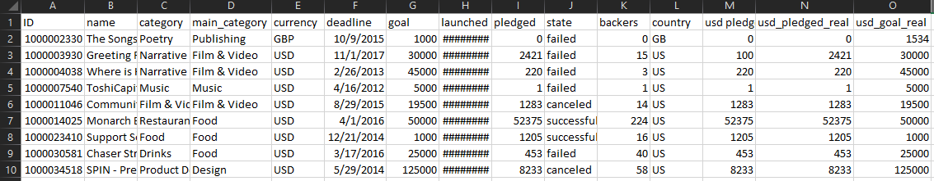


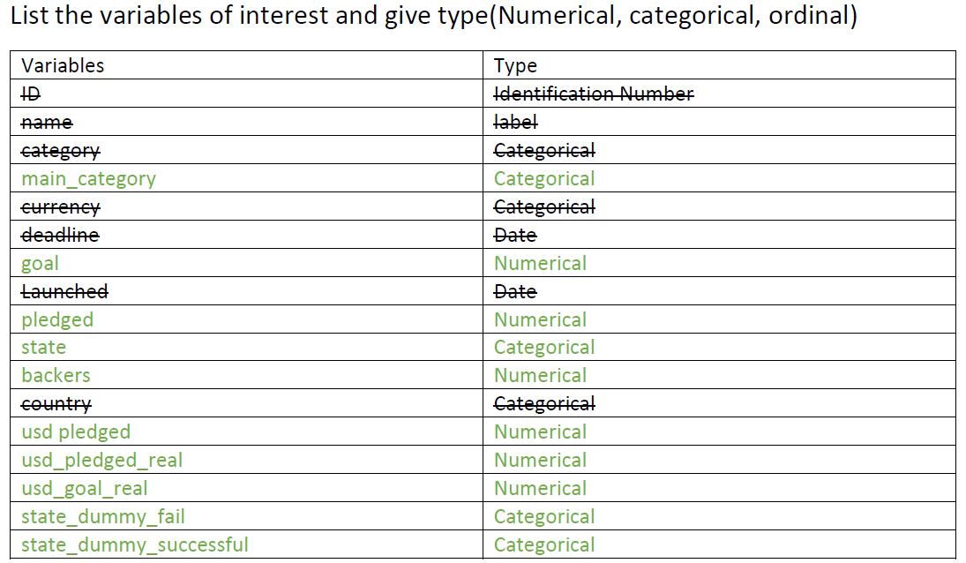

Snipe of Original Dataset.

Slide 4
Data reduction & Analysis
Original Data had over more than 370,000 records
Data had lot of missing values. I used the sort option in excel to delete the entire columns/assigning value ‘0’ which had the missing and undefined values.
After finding the outcome variable “state”, I had to get rid of states which were not either fail or successful. Also added dummy variable for state.
Created dummy variable splitting the success and fail state.

Slide 5
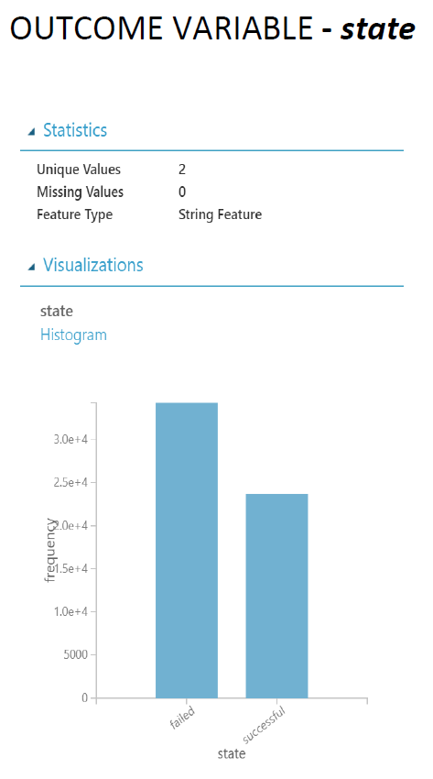
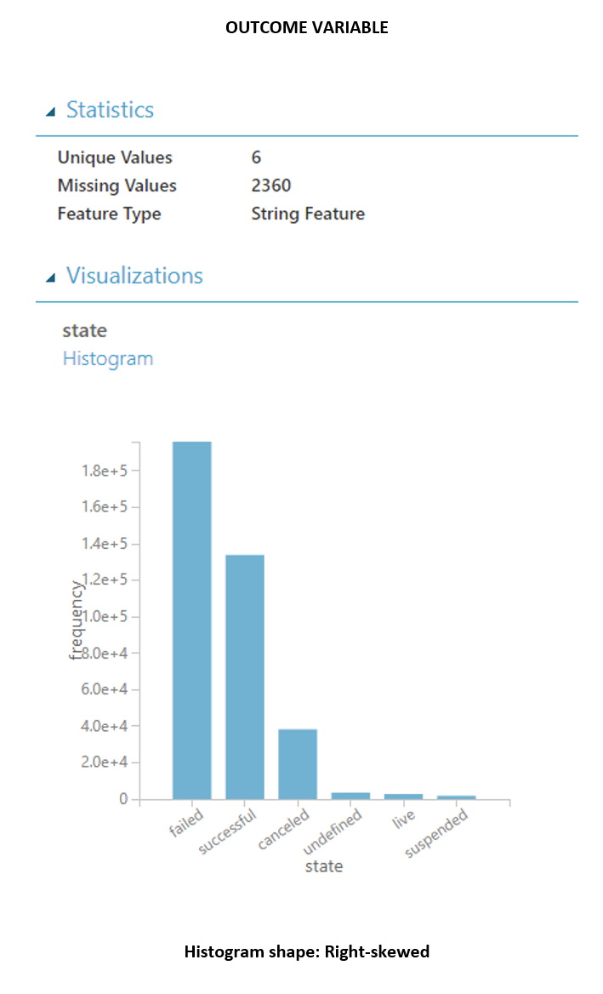
Outcome variable after clean up. Visualization in Azure studio. Univariate analysis of the outcome variable: Failed state = 34266 vs successful state = 23655

Slide 6
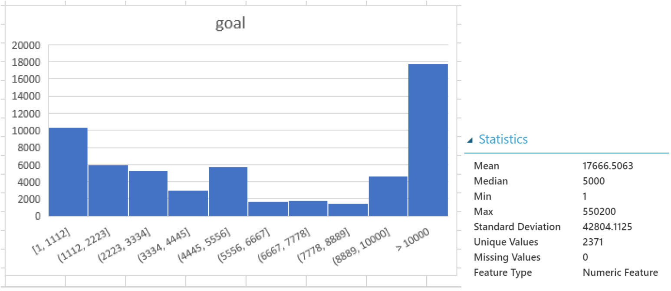
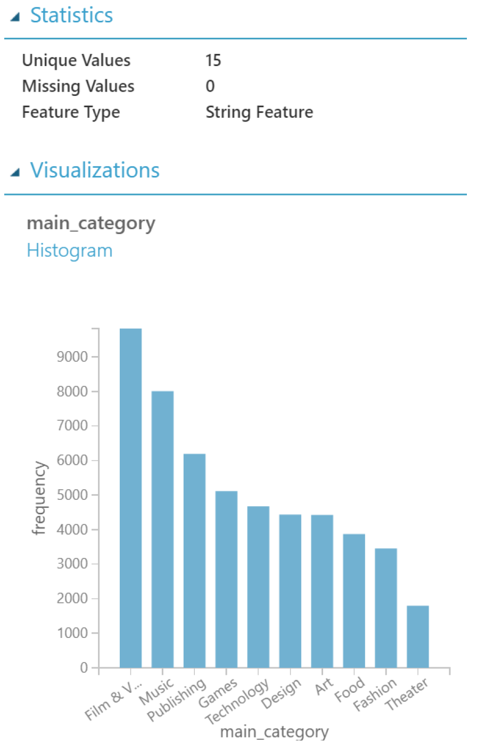
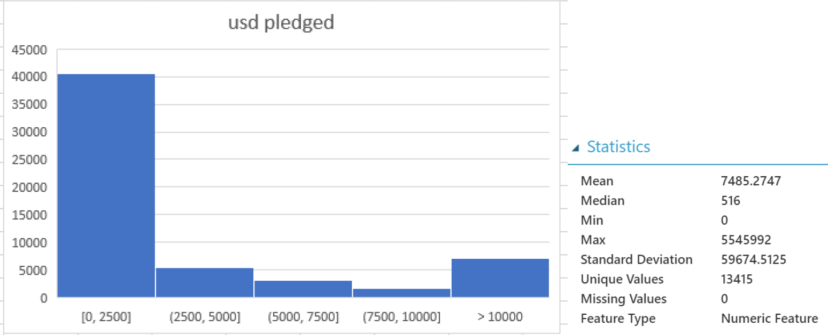
Glimpse of some histograms from the project.

Slide 7
Bivariate Analysis: Used different kind of charts to visualize the difference between main categories

Slide 8
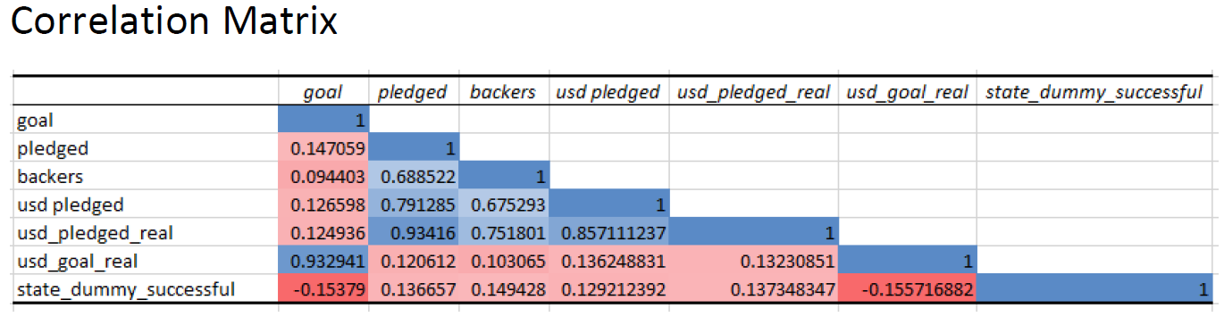
Correlation Matrix does not provide high values for the success dummy sate.
Box plot failed state median: 2440
Box plot for success state median:1137

Slide 9
Azure Classification model and Regression

Slide 10
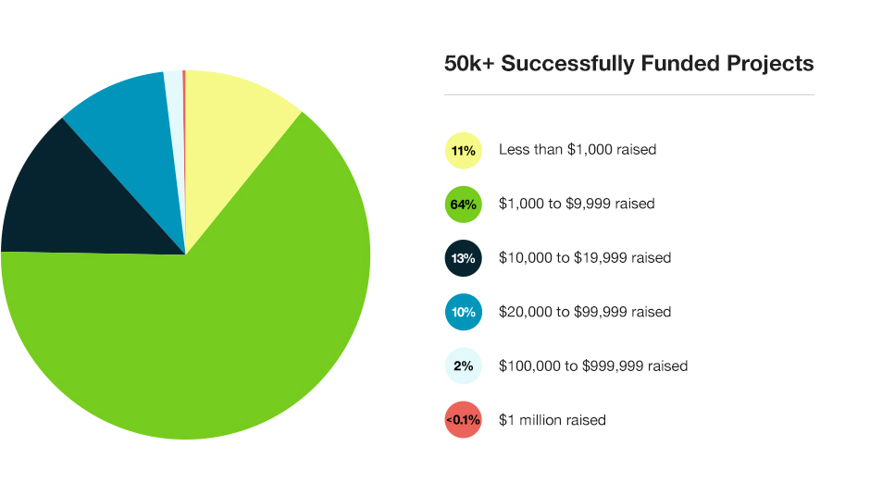
Interesting Findings and Conclusions
Based on the data, choosing the category wisely increases the chances of the success rate of the project. In some cases, like comics, Theatre the trend shows high success for categories which are not very popular and attracts niche customers.
Popular categories like technology have high failure rate.
Music has the highest count and has the best success ratio.
Goal is a very important factor. The company needs to set a reasonable goal. This can be determined setting up for a goal with similar categories in the data set.
The correlation between the goal and the success can only be determined after the backers have invested in the project but it doesn’t guarantee success.

Slide 11
What action can be taken as a result of your findings?
Kickstarter projects are entirely driven by crowdfunding where the interest of general public and their money is what sends the projects into production.
The results can help the forecast of new projects and funders by category for the upcoming year, beneficial to help individuals and start ups who wish to launch their idea.
It can also provide insight to certain types of media which are more prone to success on the platform.

